Slide 1
GLOBAL HOME AUTOMATION SMART CITY
Banuri Harshith
Bollampally Vamshi Krishna
Dandanayakula Vamshi Krishna
Batch-6

Slide 2
LITERATURE REVIEW

Slide 3
Home automation networks: A survey Author Guilherme Mussi ToschiLeonardo Barreto CamposCarlos Eduardo Cugnasca
Highlights:
•Presents different definitions and concepts of the smart home.
•Reviews the technologies created to enable M2M communication in smart home domain.
•Shows a comparison between standards created to enable M2M communication.
•Those technologies have strong market competition, but none is adopted universally.

Slide 4
Intelligent homes’ technologies to optimize the energy performance for the net zero energy home Author FadiAl FarisAdel JuaidiFrancisco Manzano-AgugliARO
Highlights:
•Intelligent homes and smart technologies are a vital strategy to optimize the energy performance.
•The level of buildings intelligence will significantly contribute the improvement of energy performance.
•The renewable energy systems in such smart homes will be a cost-effective option.
•A case study in Riyadh – Saudi Arabia about smart home’s technologies was studied.
•It was found that improves the energy performance by 37% better than ASHRAE standards for family villas sector.

Slide 5
Smart City and IoT Author Tai-hoonKim CarlosRamos SabahMohammed

Slide 6
Intelligent Street Lights Y M Jagadeesha , S Akilesha , S Karthika*, Prasantha

Slide 7
Automatic surveillance in transportation hubs: No longer just about catching the bad guy Author SimonDenman^{a b}TristanKleinschmidt ªDavidRyan^{a b}PaulBarnes ªSridhaSridharan ^{b}ClintonFookes
Highlights
•Surveillance and video analytics systems are typically only used for security.
•We explore how emerging video analytics can support security and operations needs.
•A conceptual framework combining security and operations is proposed.
•An analysis of the proposed framework as applied to an airport is presented.
•We show how many technologies have dual applications, and the benefits this brings.

Slide 8
Geometric Path Planning for Automatic Parallel Parking in Tiny Spots Author HélèneVorobieva *SébastienGlaser* *NicoletaMinoiu-Enache *SaïdMammar

Slide 9
DEFECTS AND ITS ENHANCEMENT OF THE ABOVE RESEARCH

Slide 10
1. Home automation networks: A survey
Defects:
Its an local control.
We cant operate multiple devices at the same time.
Enhancement:
We will be making it as an global control.
We will operating multiple devices at the same time.

Slide 11
2. Intelligent homes’ technologies to optimize the energy performance for the net zero energy home
Defects:
It is an local control.
Net zero energy home.
Enhancement:
Making it an global control.
Neglecting the net zero energy home.

Slide 12
3. Smart City and IoT
Defects:
Limited upto Arduino.
Enhancement:
Usitilizing Arduino with raspberry pi.

Slide 13
4. Intelligent Street Lights
Defects:
It mainly works on IR sensor.
Enhancement:
Replacing the IR sensor with the LDr sensor.

Slide 14
5. Automatic surveillance in transportation hubs: No longer just about catching the bad guy
Defects:
Not been able to be implemented to an city.
Enhancement:
Making it as an city accessory.

Slide 15
6. Geometric Path Planning for Automatic Parallel Parking in Tiny Spots
Defects:
It is an iterative algorithm method which is not much effective.
Enhancement:
Using IR method.

Slide 16
DESIGN AND MODELLING

Slide 17
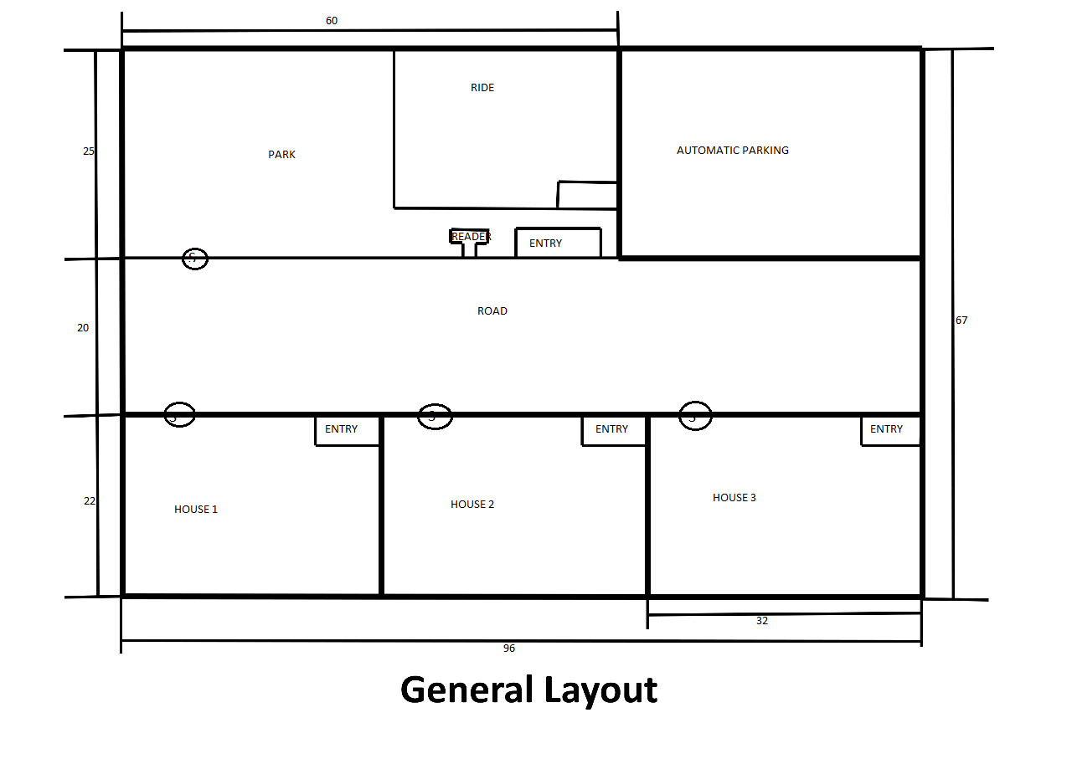
GENERAL LAYOUT

Slide 18
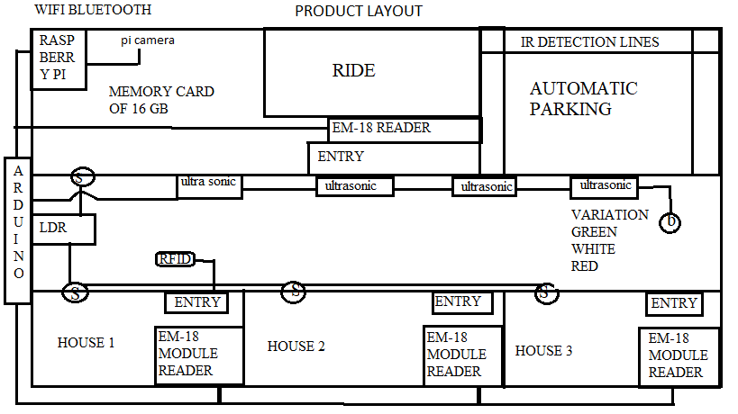
PRODUCT LAYOUT

Slide 19
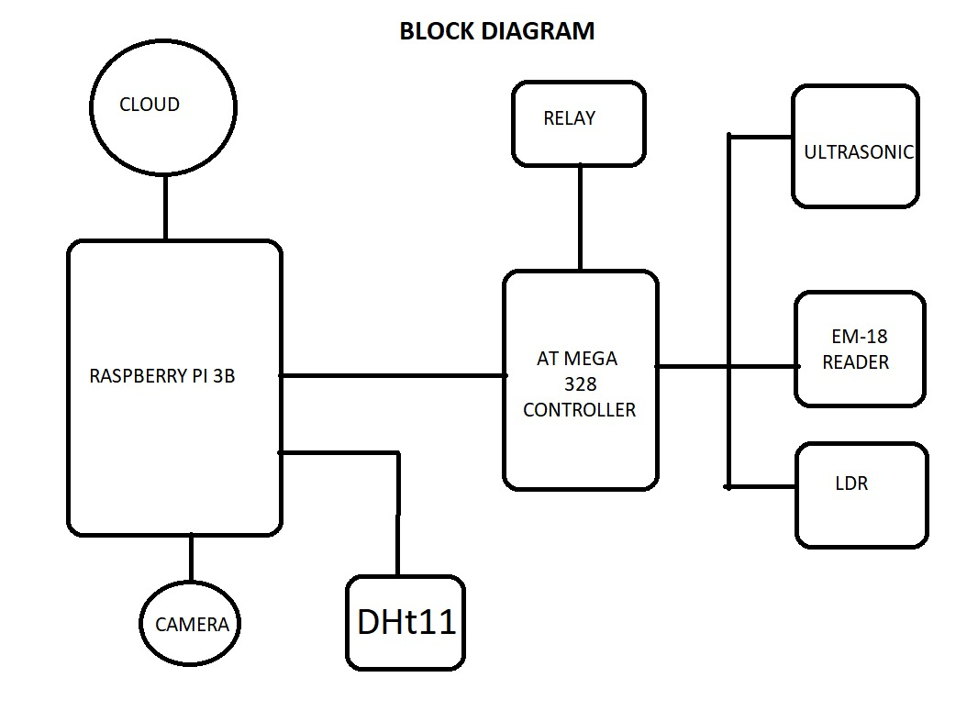
Block diagram

Slide 20
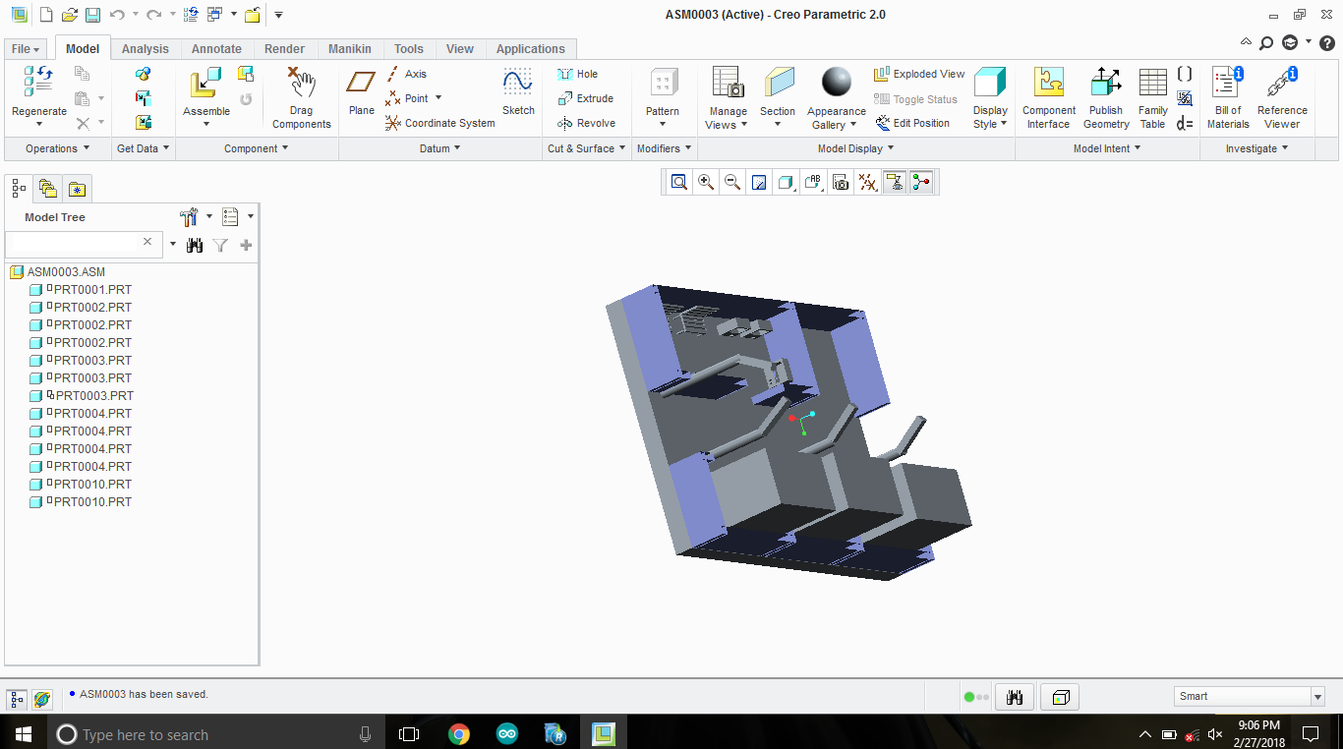
Modelling

Slide 21
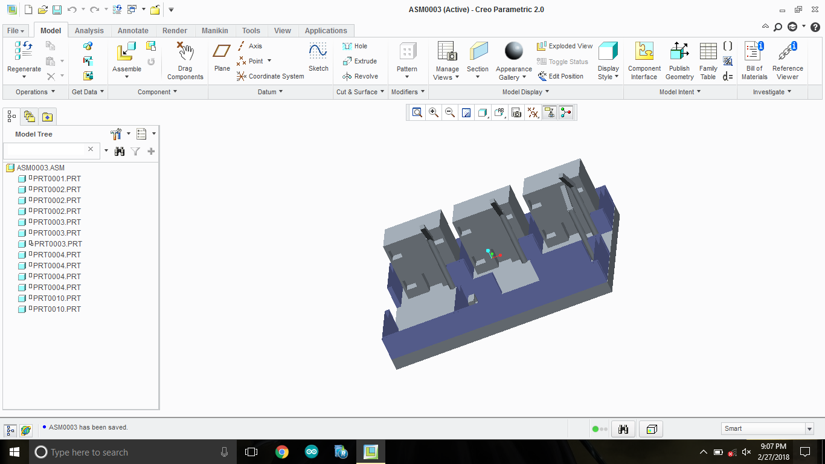

Slide 22
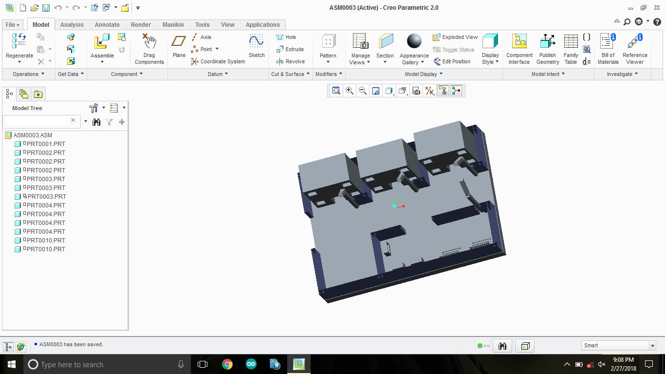

Slide 23
Parts used

Slide 24
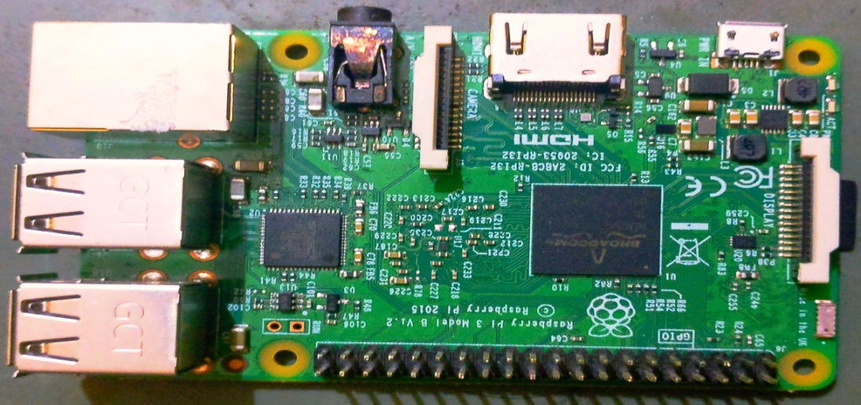
Raspberry pi

Slide 25
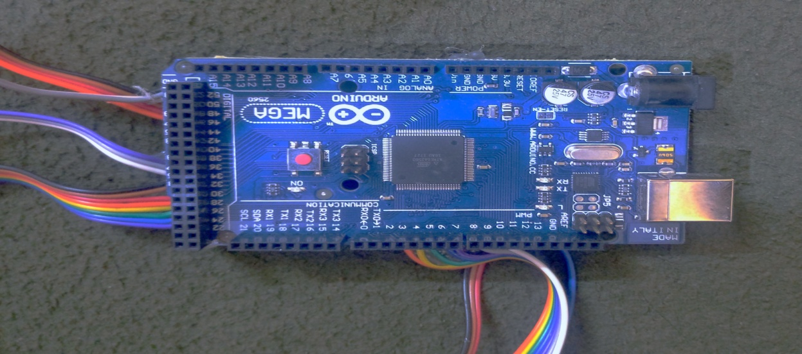
Arduino

Slide 26
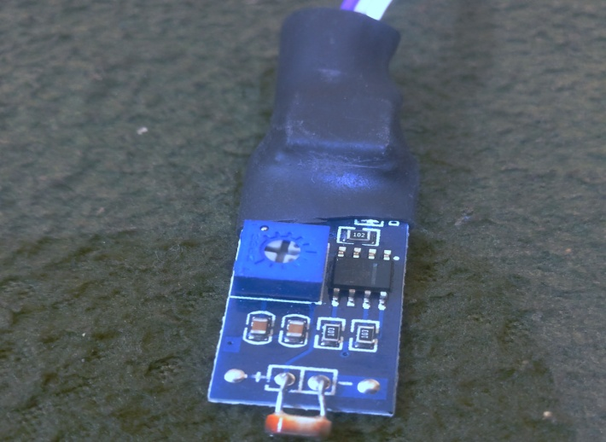
Ldr sensor

Slide 27
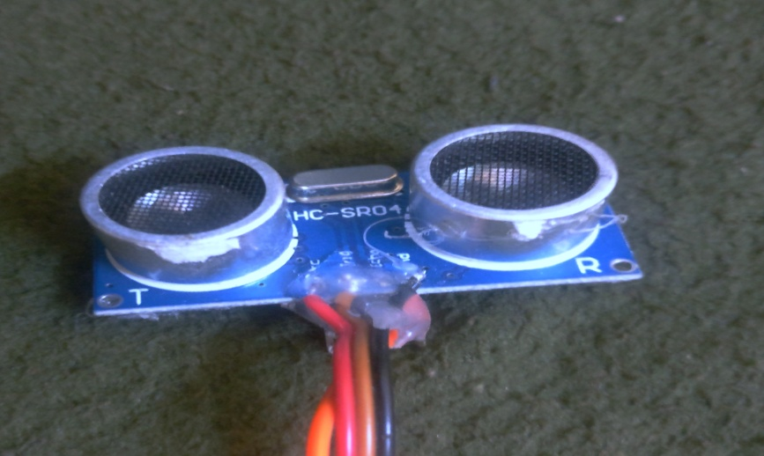
Ultrasonic sensor

Slide 28
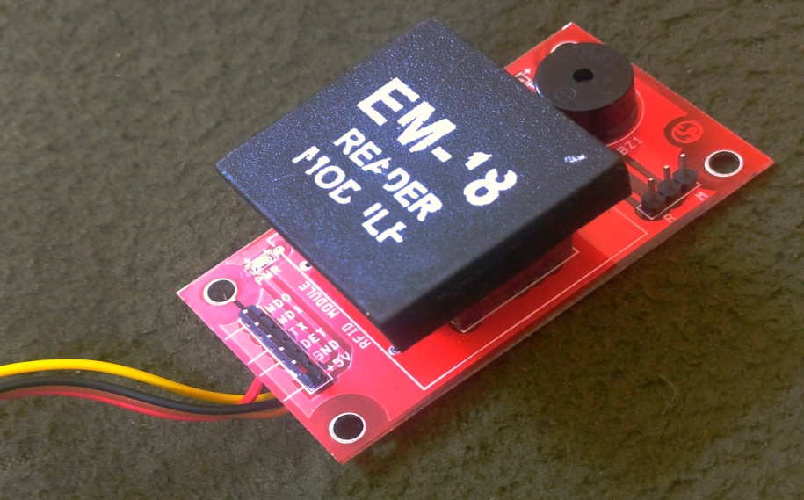
Em-18 module reader

Slide 29
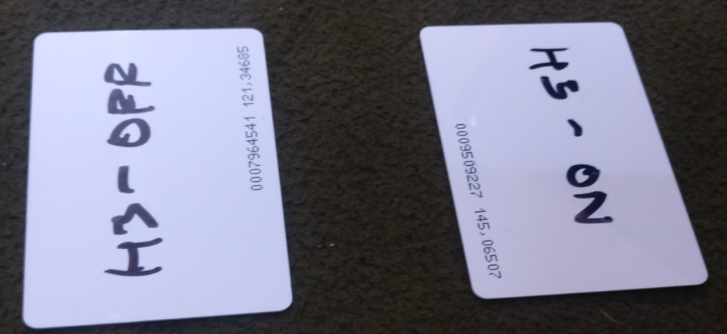
Rfid

Slide 30
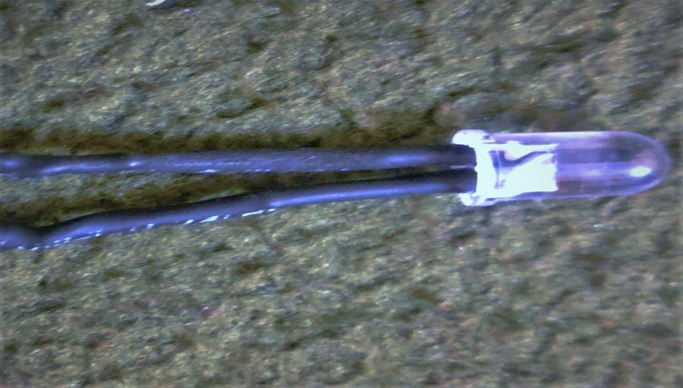
Led

Slide 31
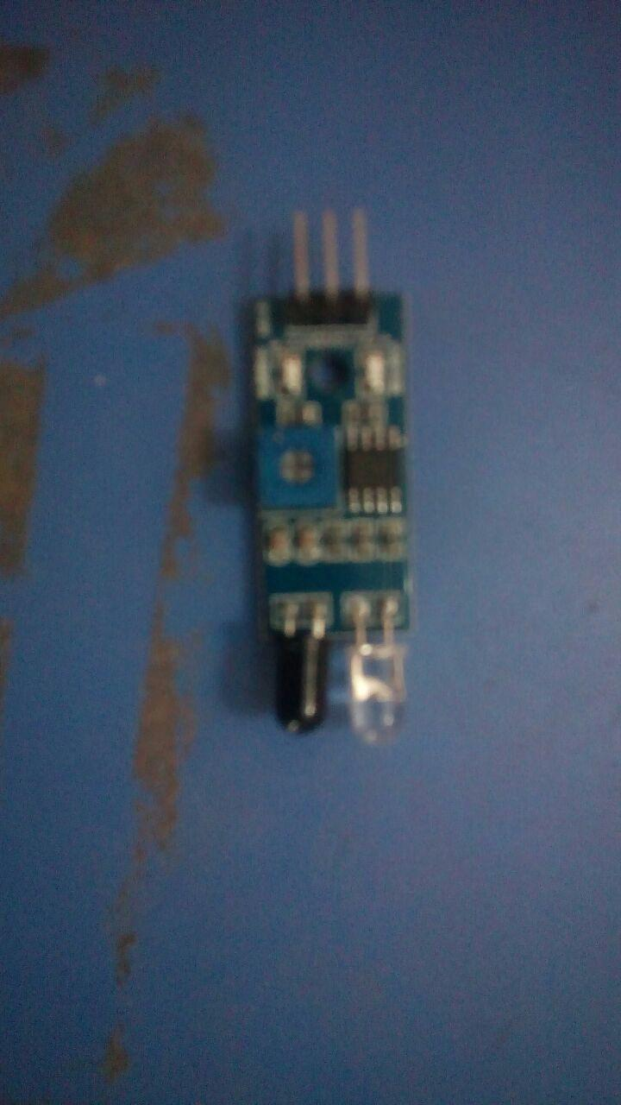
Ir sensor

Slide 32
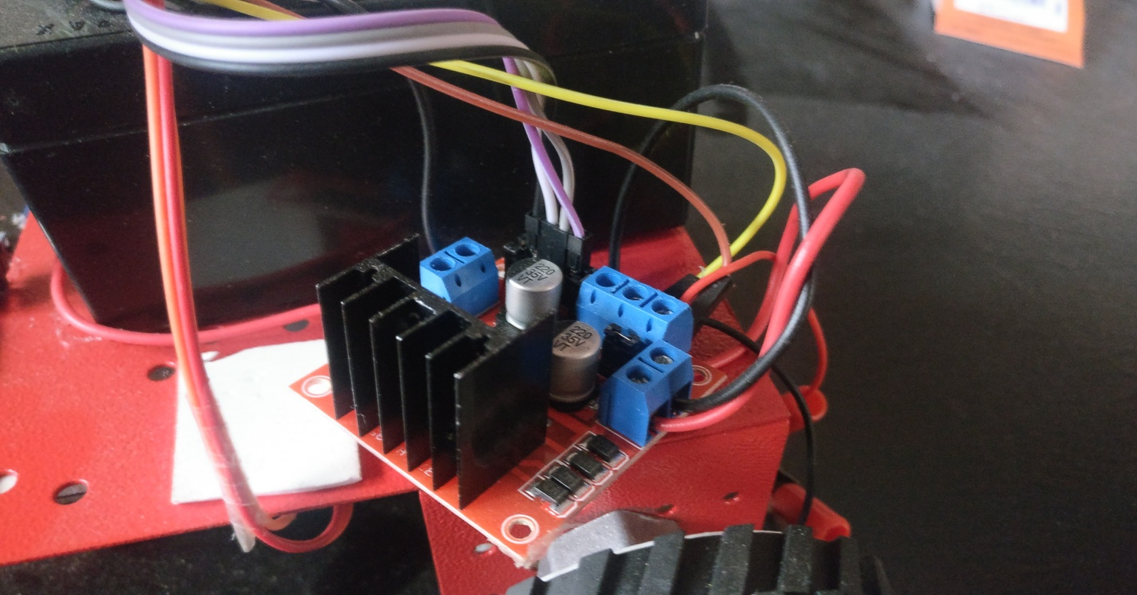
Motor drive

Slide 33
Working on arduino

Slide 34
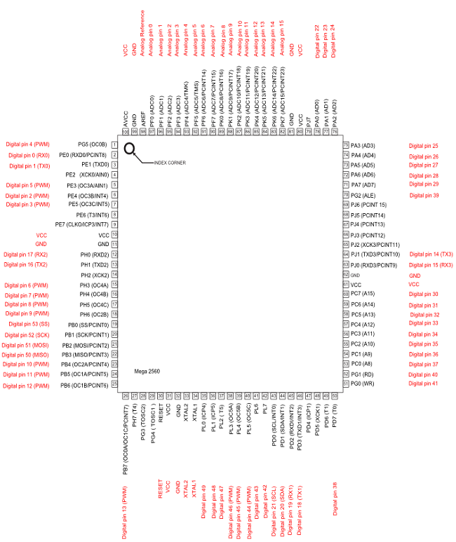
Arduino pin description

Slide 35
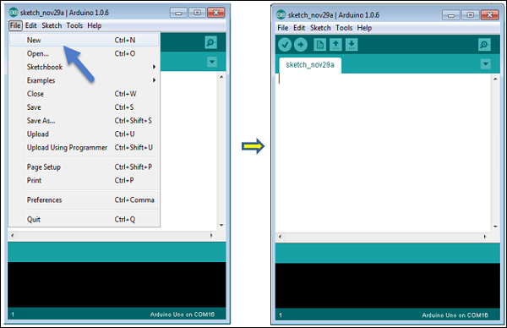
Arduino programming interface

Slide 36
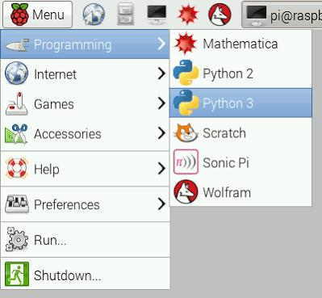
Raspberry pi programming interface

Slide 37
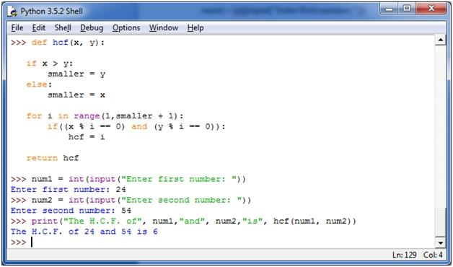

Slide 38
Smart city analysis

Slide 39
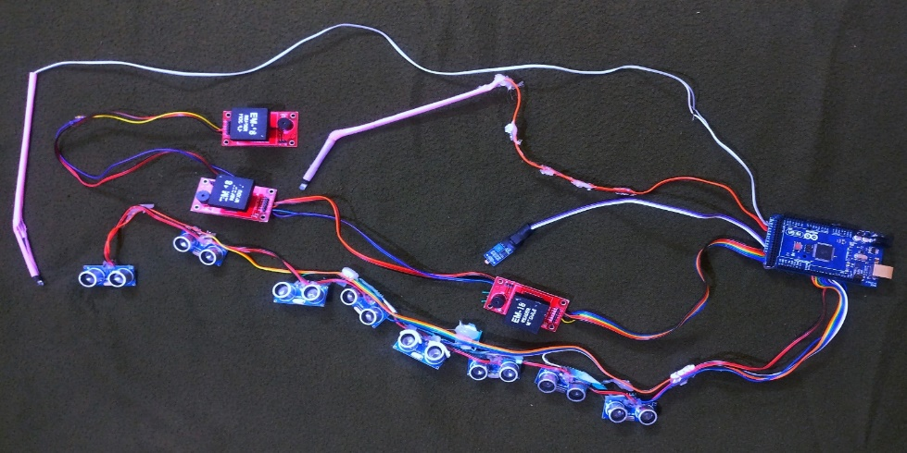
Arduino connections

Slide 40
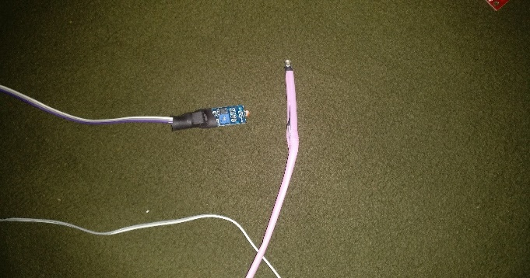
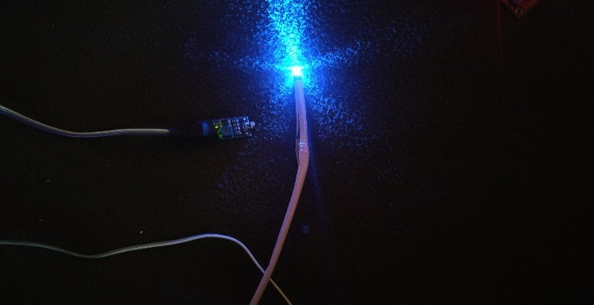
Showing working of ldr

Slide 41
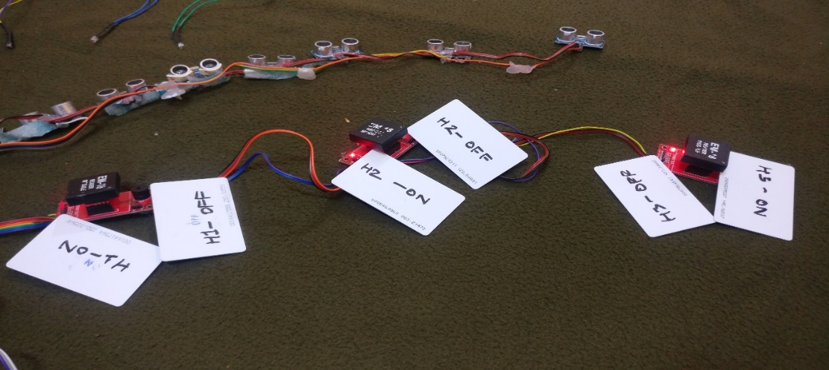
Em-18 module reader

Slide 42
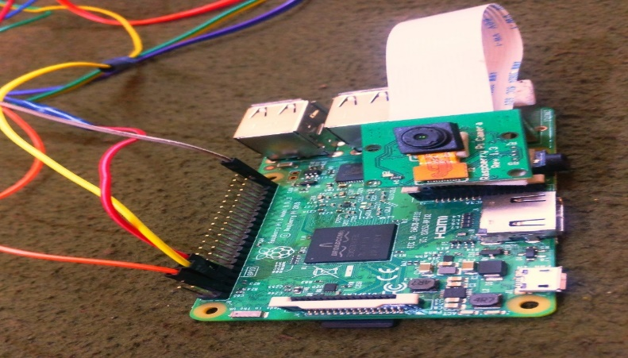
Raspberry pi connections

Slide 43
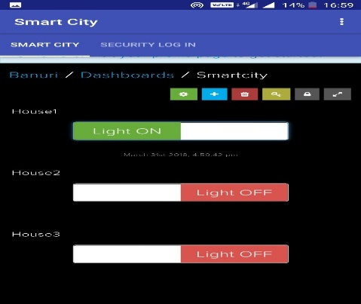
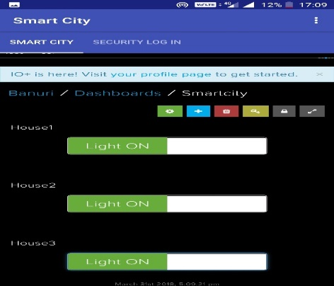
Working of smart city application

Slide 44
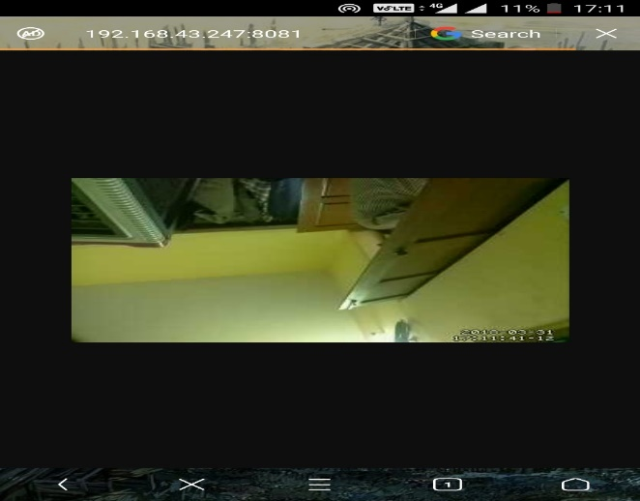
Showing camera feed

Slide 45
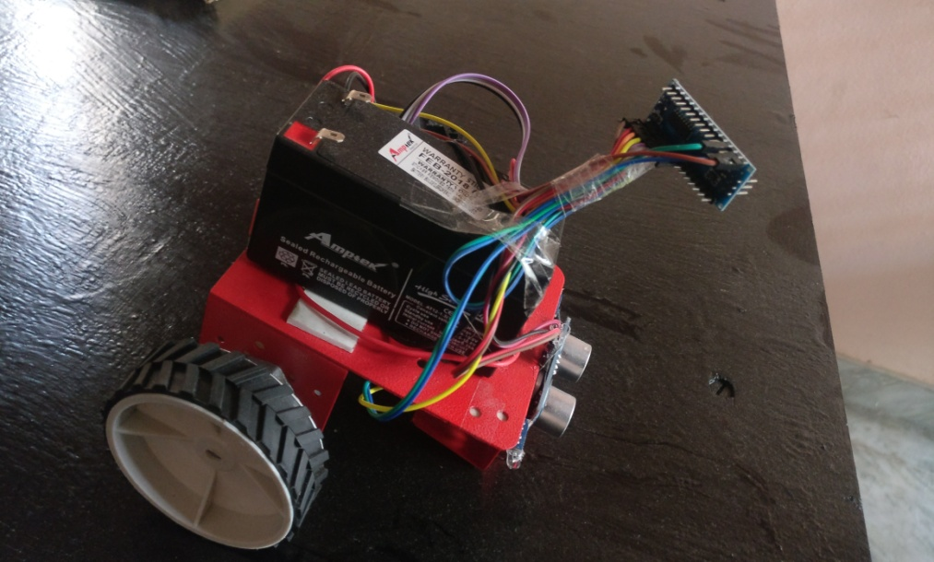
Automatic parking car

Slide 46
Thank you

